Slide 1

Estimation of Basin Level Water Budget in India 2021 Using INSAT-3D Rainfall and AET Product
Under the guidance of
Prof. Somsubhra Chakraborty | Sri. AYAN DAS | Dr. BIMAL K BHATTACHARYA
Associate Professor Agricultural and Food Engineering Department, IIT Kharagpur | SCI/ENG-SD ESPA-BPSG SAC, ISRO | SCI/ENG – GEPSA-AESG SAC, ISRO
Abhijeet T. Pawar (22AG66R03)
Agricultural Systems and Management
Agricultural and Food Engineering Department
Indian Institute of Technology, Kharagpur

Slide 2





OBJECTIVES
To conduct a comprehensive analysis of HEM Precipitation and Actual Evapotranspiration (AET) data sourced from INSAT-3D
To observe the temporal patterns, trends, and exploring the influence of these patterns on various river basins across India for year 2021.
To calculate the water surplus ratio by using high-resolution satellite data, specifically the Hydro-Estimator Method (HEM) precipitation data, and Actual Evapotranspiration(AET).
Software’s used for work
Q – GIS |  | R – Studio
Arc – GIS |  | Google - Colab
ENVI

Slide 3
Review of literatures
Author | Year | Findings
Yucel et al. | 2010 | - Evaluated the Hydro-estimator satellite rainfall algorithm over a mountainous region -According this study HE and Observation shows the heaviest rainfall intensities at lower elevation - lower intensities at higher elevation - model estimated runoff to be 40% of rainfall in all basins
Kumar and Varma | 2016 | - Compared the INSAT- 3D HE rainfall data with Tropical Rainfall Measuring Mission (TRMM) and Indian Meteorological Department (IMD) insitu observations - According to this study INSAT – 3D rainfall data is reasonably good and suitable for various meteorological applications

Slide 4
Mitra et al. | 2018 | - Estimated rainfall, which bound the Hydro-Estimator Method (HEM), INSAT Multi-spectral rainfall (IMR), and Quantitative Precipitation Estimation (QPE), in the context of heavy rainfall event analysis within the Indian region. - These estimations are systematically compared against the IMD's surface in-situ rain gauge data - HEM shows good correlation (r > 0.7) in detecting heavy rainfall
Singh et al. | 2021 | - Validation of nowcasting model NETRA (Nowcasting of Extreme Orographic Rain Occurrence) with QPE ( Quantitative Precipitation Estimate) data - Got correlation (r > 0.7) - Model have high heavy rainfall detection probability. (May to October)
Singh et al. | 2021 | - Estimated potential evapotranspiration (PET) over an agricultural region using INSAT-3D satellite data. -Leveraging the Hamon method and INSAT-3D dataset, annual PET variations in the Varanasi region were evaluated

Slide 5
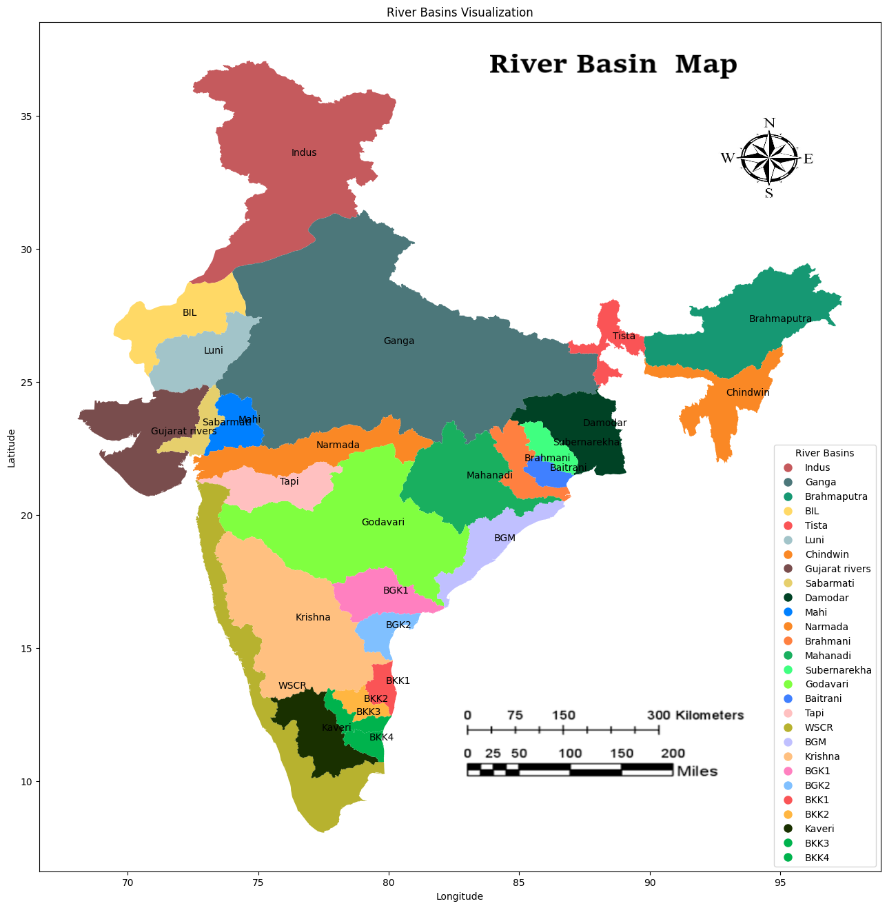
STUDY AREA
Fig. Study Area (River Basins in India)

Slide 6
Data Source and Format
Product Name | Spatial Resolution | Temporal Resolution | Format | Source
Actual Evapotranspiration | 4 km x 4 km (0.036° × 0.036) | Daily | .tiff | (SAC), ISRO INSAT – 3D Satellite https://www.mosdac.gov.in
HEM Precipitation | 4 km x 4 km (0.036° × 0.036) | 30 minutes | .tiff
Actual Evapotranspiration | 750 m x 750 m (0.0068° × 0.0068°) | Daily | .tiff | (NRSC), ISRO https://bhuvannhp.nrsc.gov.in
Gridded Rainfall Data | 27.5 km x 27.5 km (0.25° × 0.25°) | Daily | NetCDF | IMD https://www.imdpune.gov.in/cmpg/Griddata/Rainfall_25_NetCDF.html
* Validation :- (Validated daily rainfall records from 6995 rain gauge stations in India)
* Validation :- (Validated with flux tower data)

Slide 7
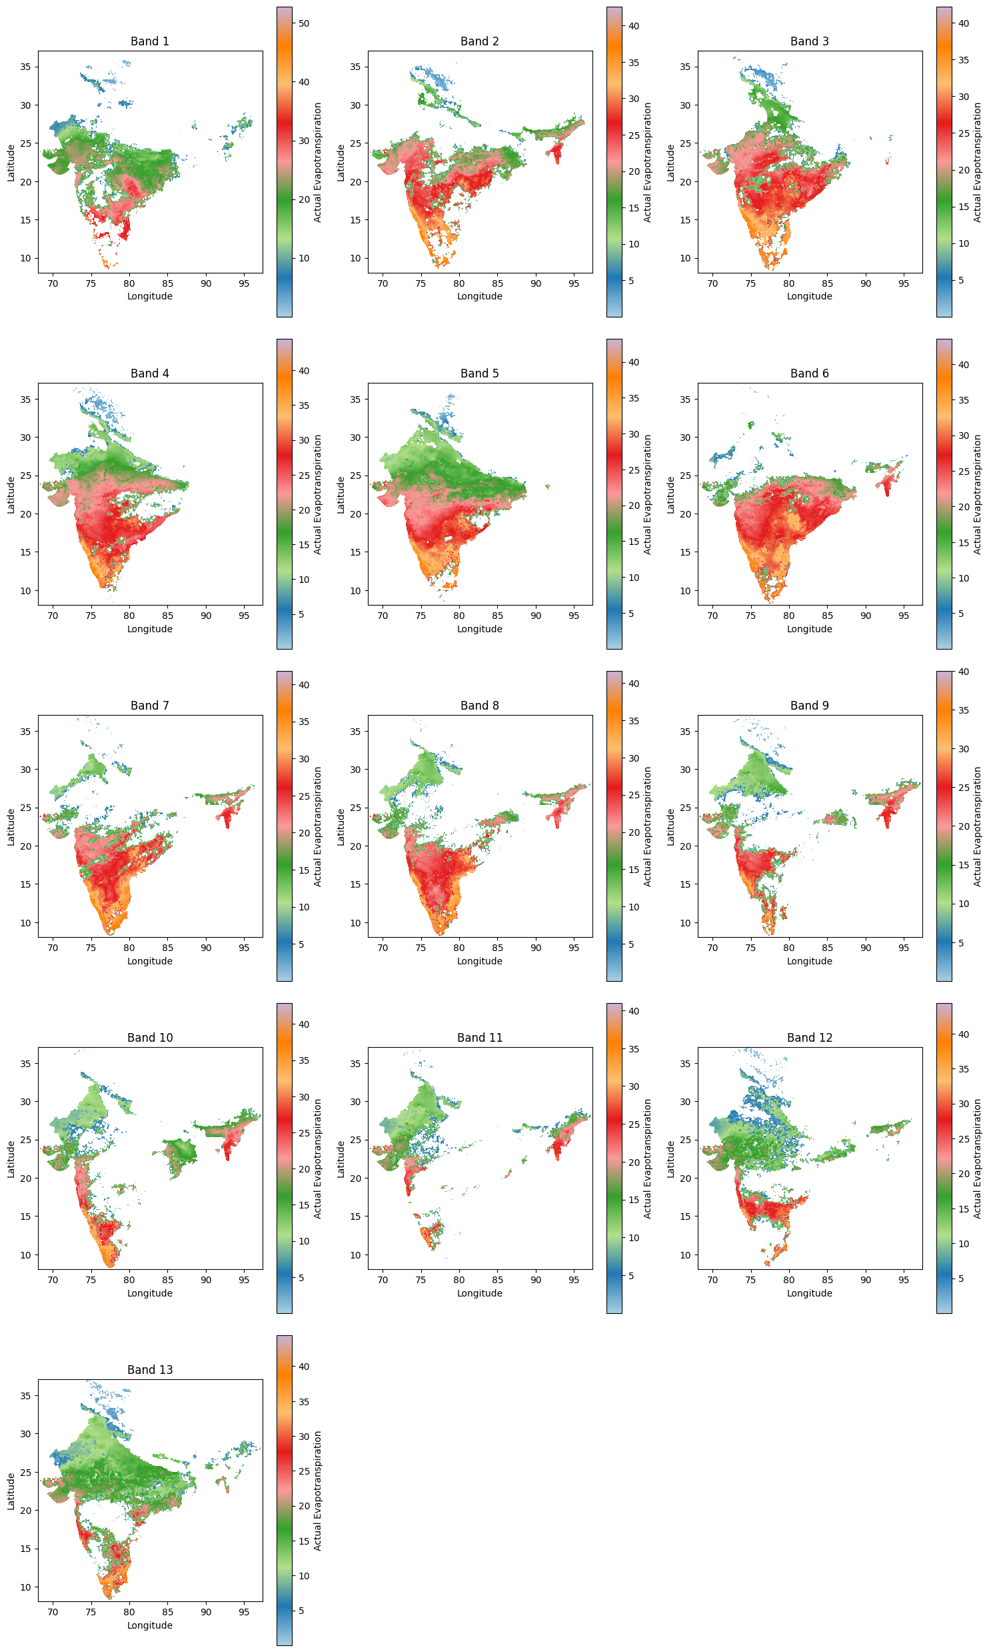
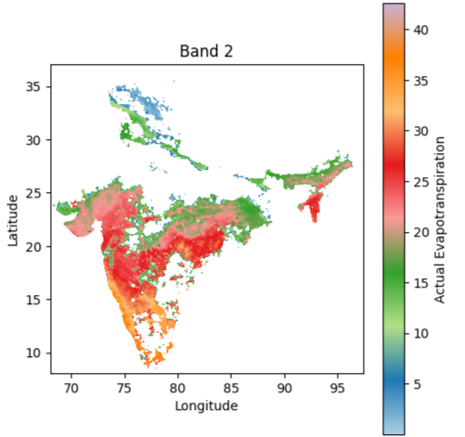
AET Raw Data :-
Gaps (missing values)
Fig. Actual Evapotranspiration Raster Stacked Image 01 to 15 January 2023

Slide 8
Different Gap Filling Methods:-
Savitzky Golay Filter
Used for smoothing the temporal data
0 degree polynomial with Different window sizes. (moving average)
Y_{i} = 1/3 * (Y_{i-1}+ Y_{i} +Y_{i+1})
B. Average of time series data (custom approach)
Identify pixels with 0 or non-positive values in each band.
Search the positive values for the same pixel in other bands.
Calculate the average of only available positive value pixels.
Assign the average value to pixels with non-positive or 0 values.
C. 15 Day Max Value Composite
Calculated 15 Day Max Value Composite

Slide 9
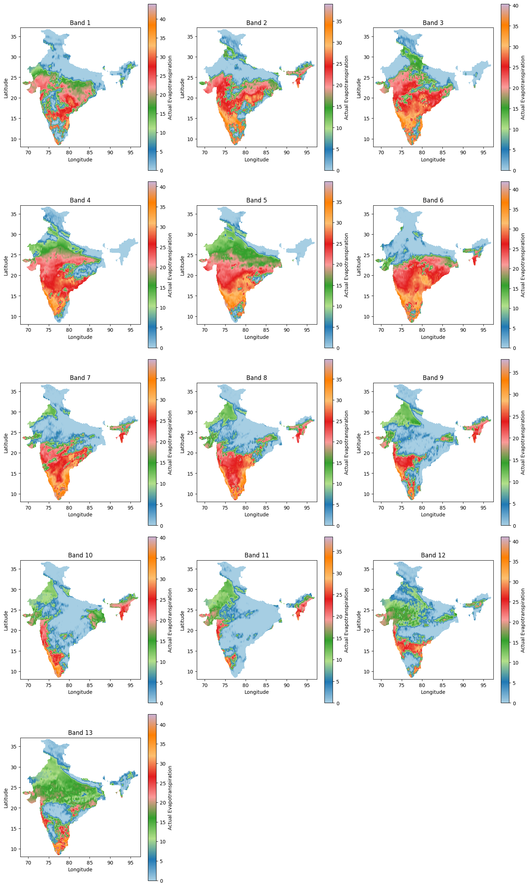
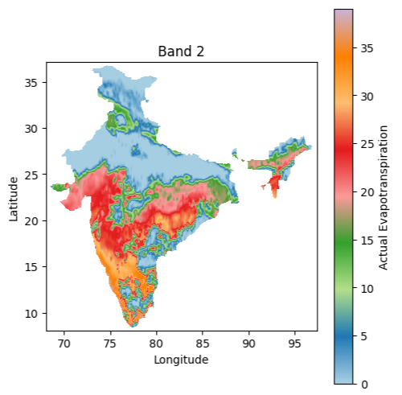
Savitzky Gaolay Filter
(PD-0, W-13)
Fig. S – Golay filter effect on Actual Evapotranspiration Raster Stacked Image

Slide 10
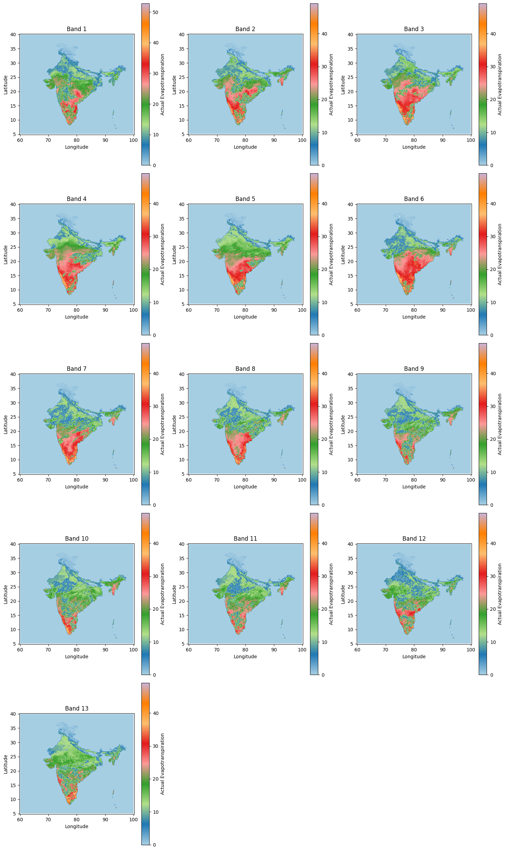
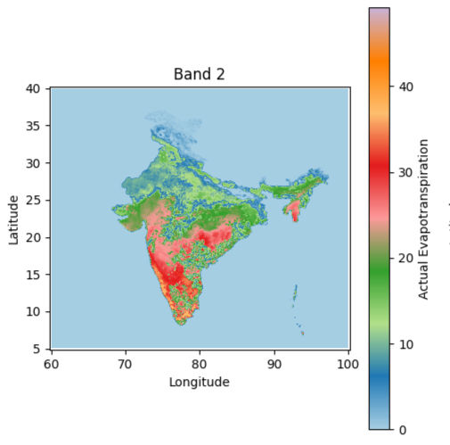
Average of time series data
(custom approach)
Fig. Average method effect on Actual Evapotranspiration Raster Stacked Image

Slide 11
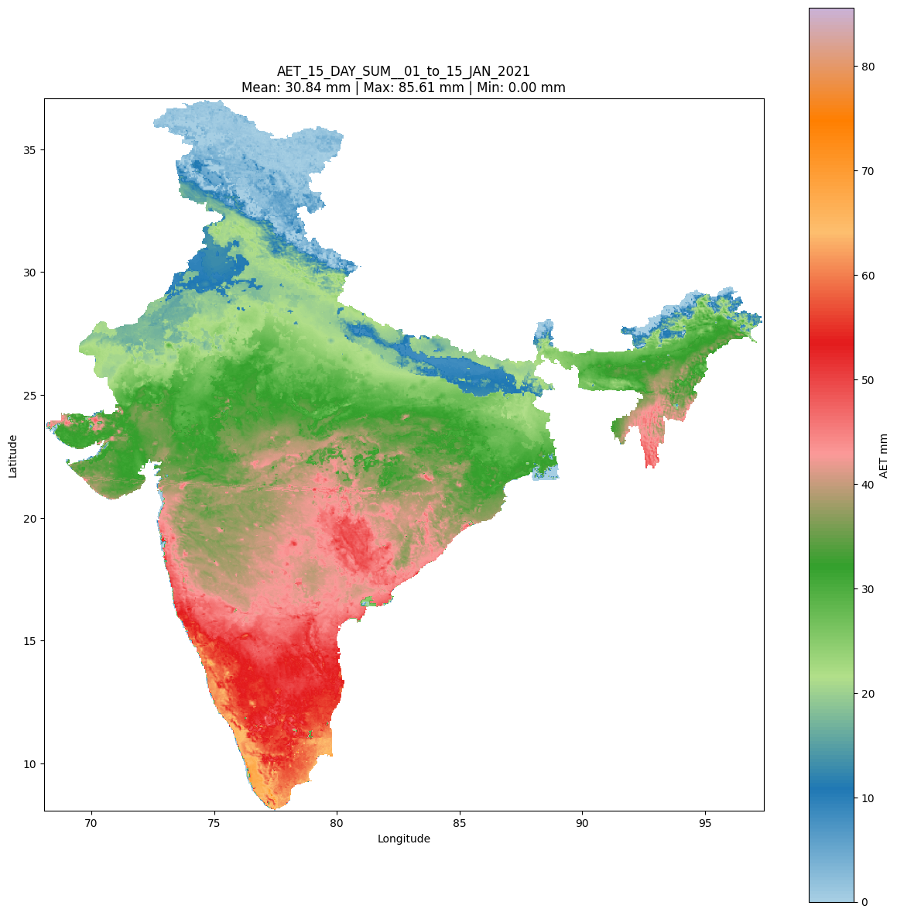
Max Value Composite :-
15 Days
Fig. 15 day max value composite of Actual Evapotranspiration Raster Stacked Image 01 to 15 January 2023

Slide 12
Original
S-Golay filter
Average
Max Value Composite

Slide 13
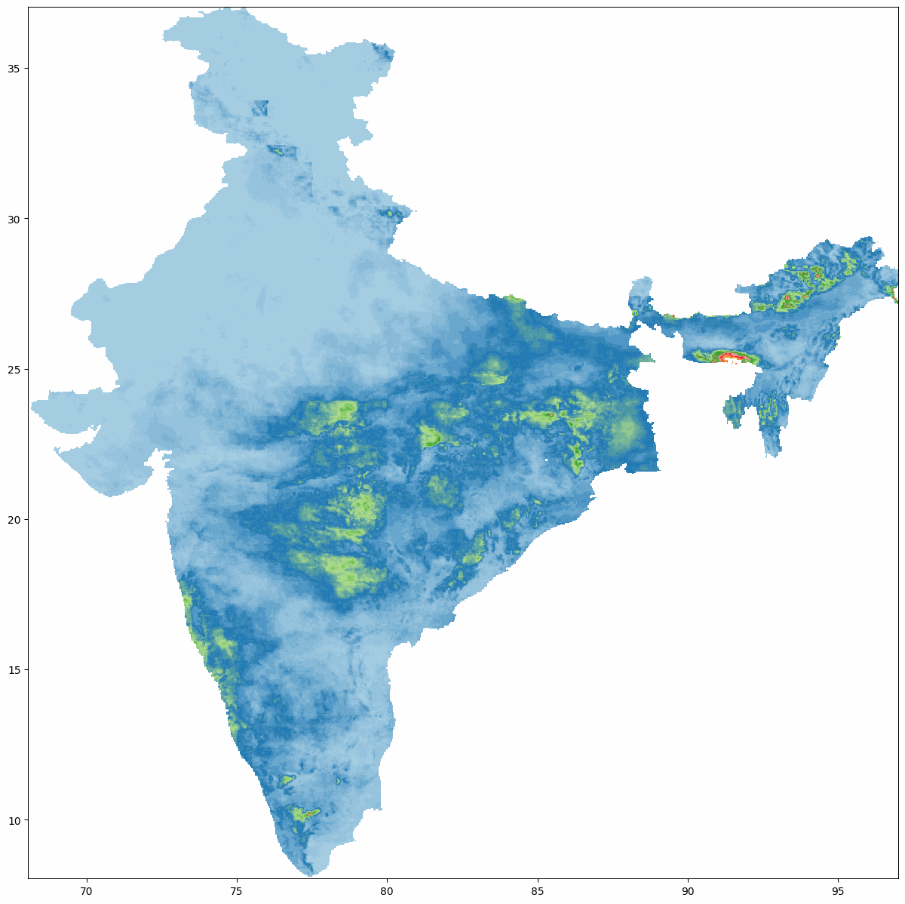

Data Visualization
Image. Monthly HEM Rainfall sum India2021
Image. 15 day max value composite AET sum India2021

Slide 14
Methodology
A) HEM Precipitation Sum
HEM Precipitation Data Downloading Source – INSAT 3D (30 minutes duration) 2021
Calculation of Sum daily basis using R- studio (Sum of available files/ nos. of files) *24 | Stacked the data files for daily basis 48 files to see temporal pattern 0300 GMT to 0230 GMT of next day
Calculated monthly sum from daily sum (R code)
Observed monthly data and removed outliers from it
Calculated sum of year 2021 Analysis of this result over different river basin

Slide 15
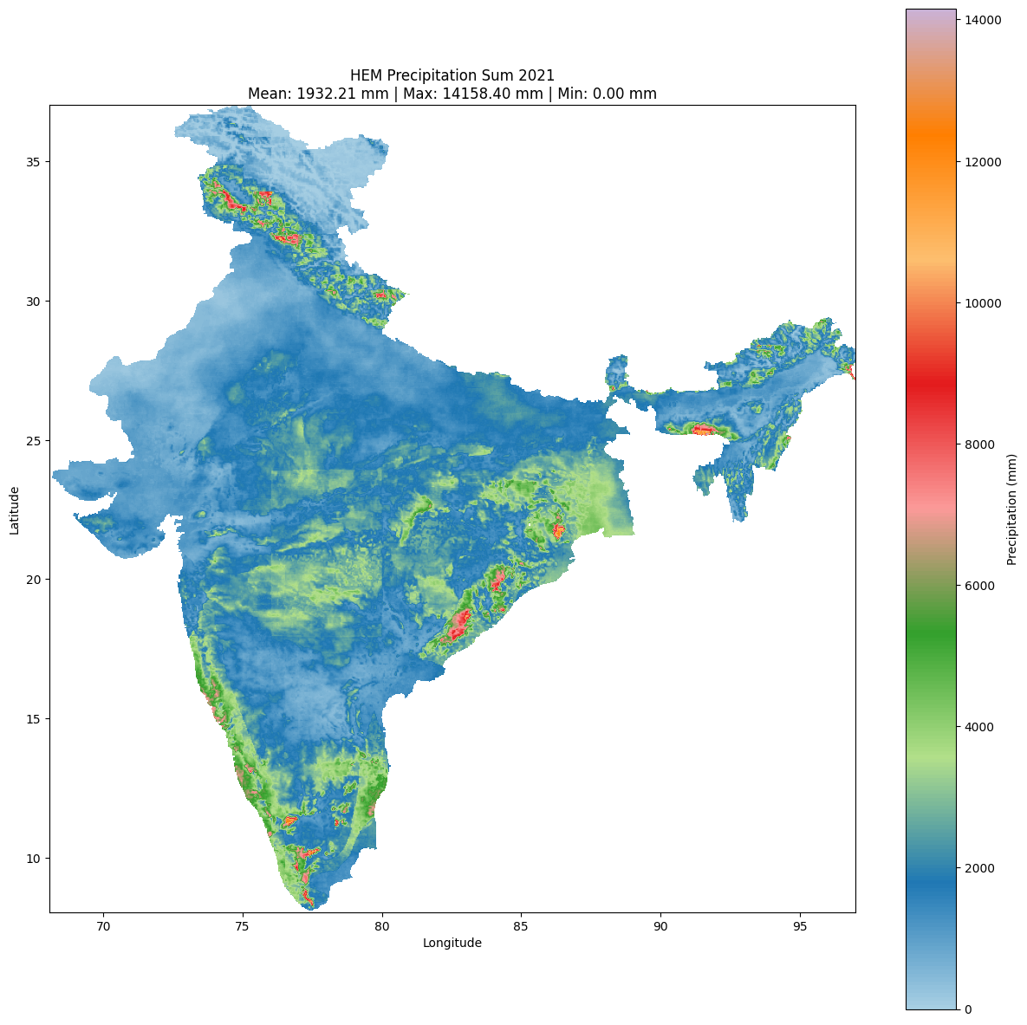
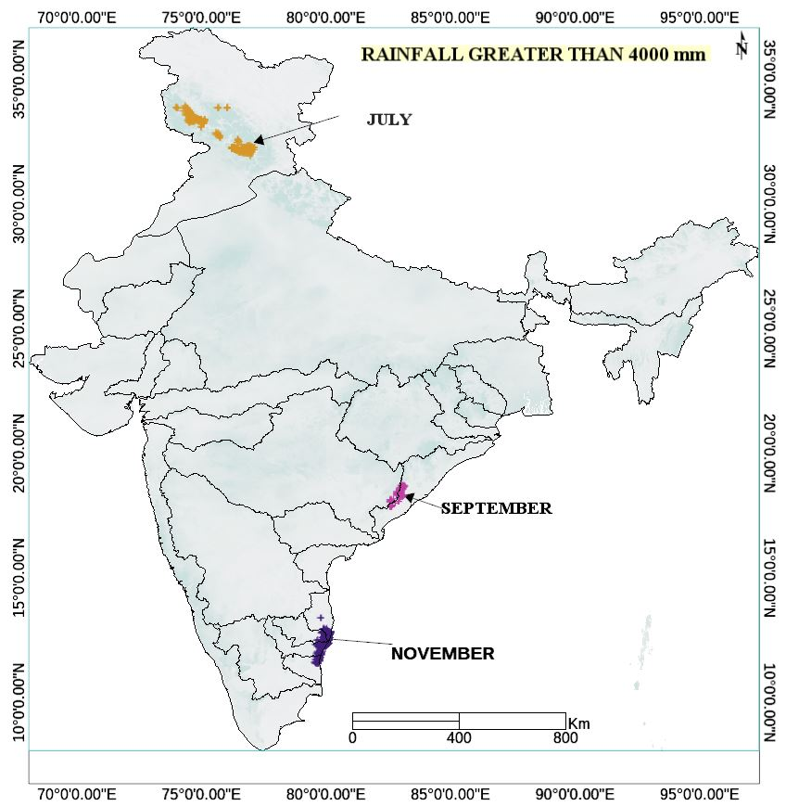
Fig. HEM Precipitation sum 2021
Fig. Removal of outliers from Precipitation data

Slide 16
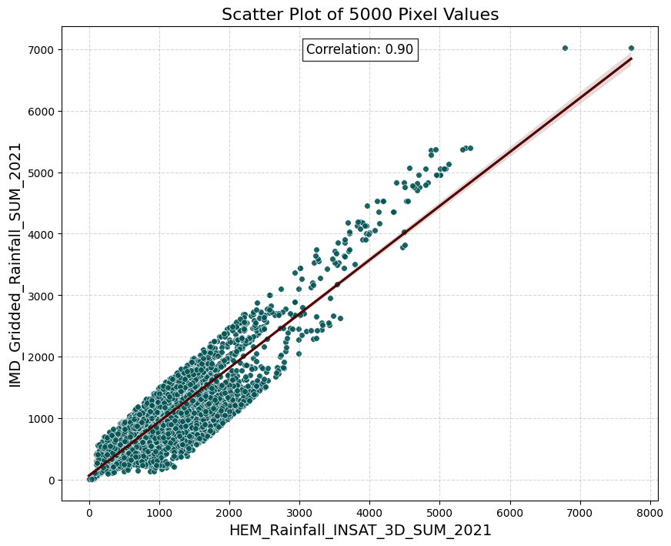
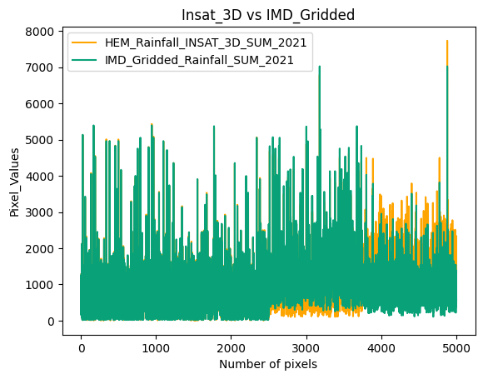
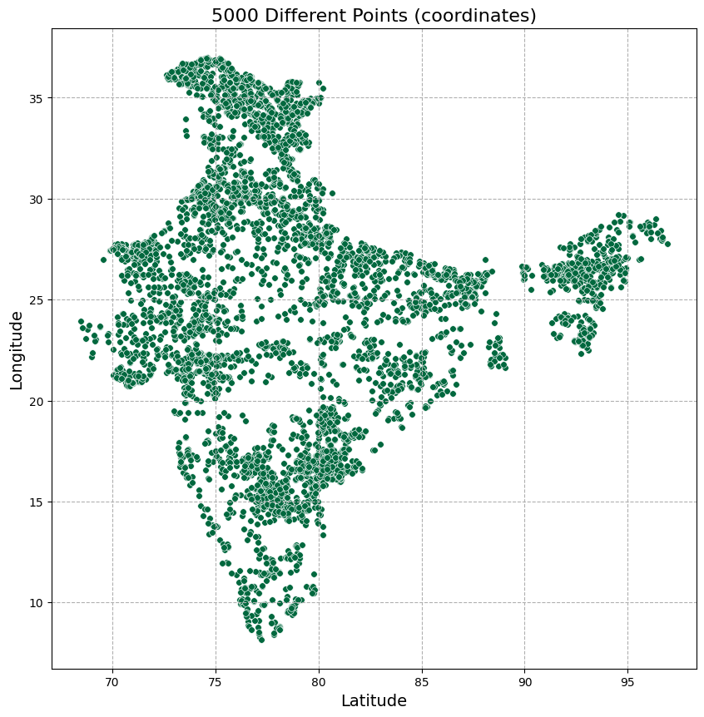
HEM Rainfall (AET) validation:-
INSAT 3D satellite HEM rainfall data is validated by using IMD gridded rainfall Data and found correlation 0.90
IMD Gridded rainfall data :- Records from a different 6995 rain gauge stations in all over India
Fig. Scatter Plot INSAT 3D Rainfall vs IMD Gridded Rainfall data
Fig. 5000 data point coordinate locations

Slide 17
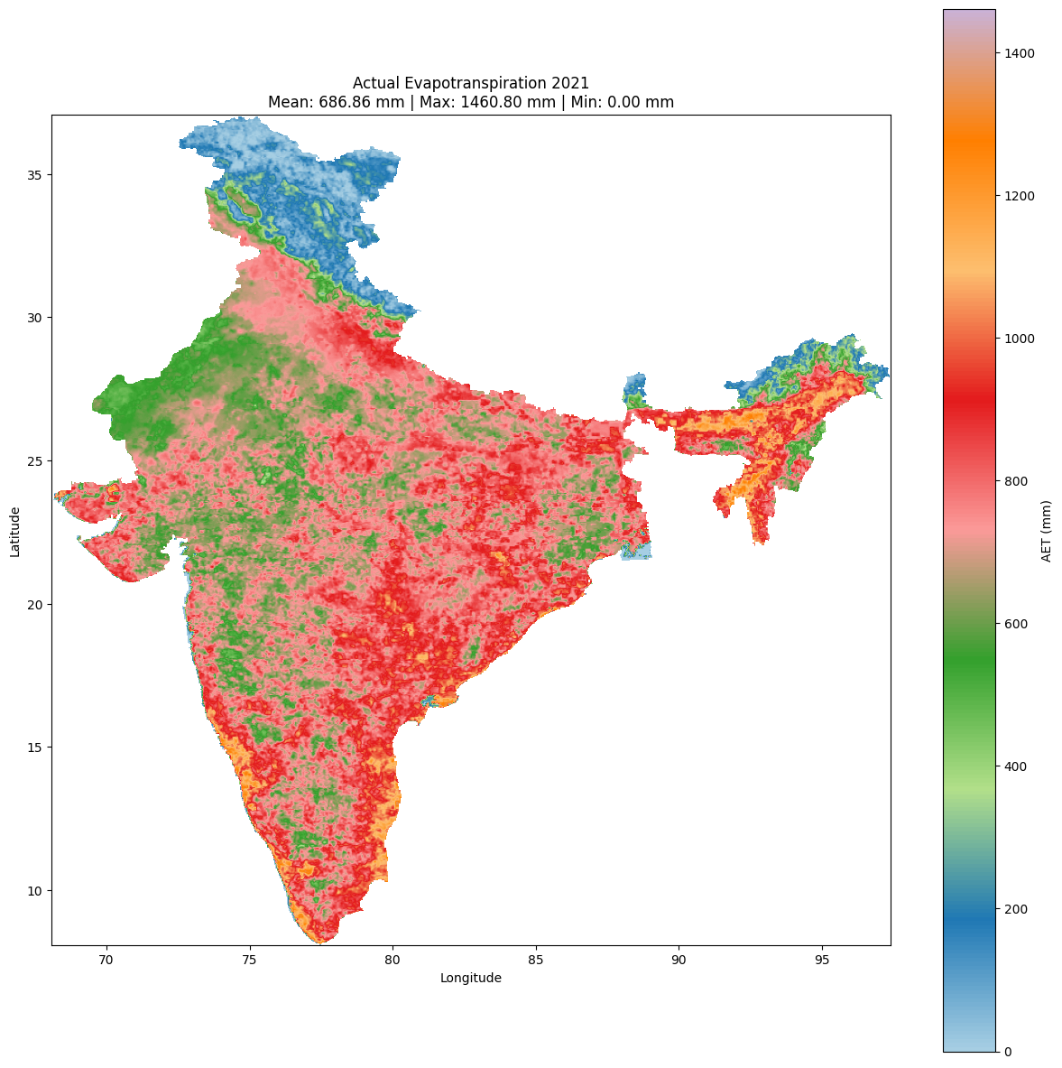
B) Actual Evapotranspiration (AET) Sum
AET Data Downloading Source – INSAT 3D (01day duration) 2021
Calculation of 15-day max value composite and then 15-day sum (15-day max value composite * 15 or 16)
Calculated monthly sum
Observed monthly data and removed outliers from it
Calculated sum of year 2021 Analysis of this result over different river basin
Fig. AET Sum 2021

Slide 18
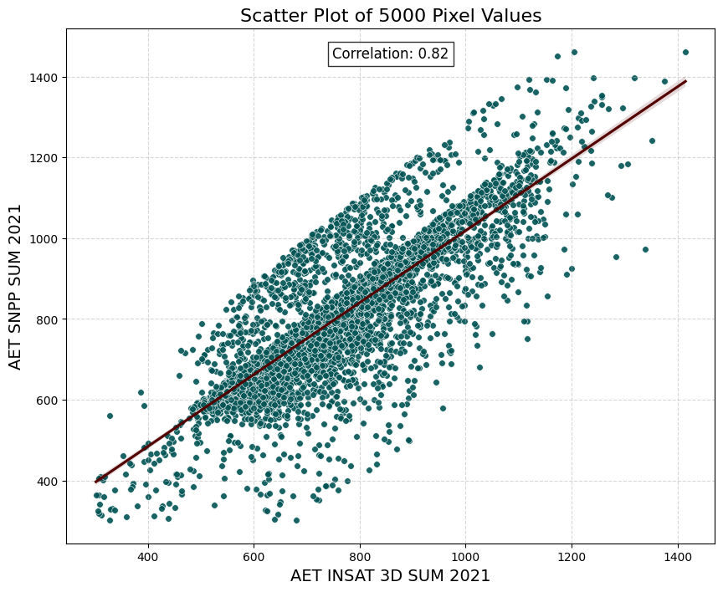
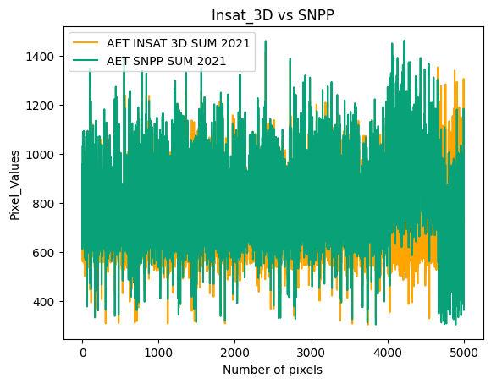
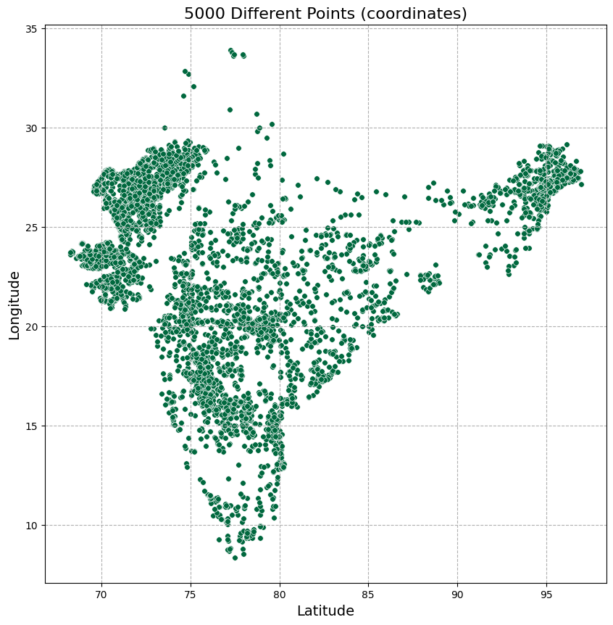
Actual Evapotranspiration (AET) validation:-
INSAT 3D AET satellite data is validated by using SNPP AET satellite Data correlation 0.82
SNPP AET data :- High resolution (750m *750m) and validated with Flux Tower Data
Fig. Scatter Plot INSAT 3D vs SNPP
Fig. 5000 data point coordinate locations

Slide 19
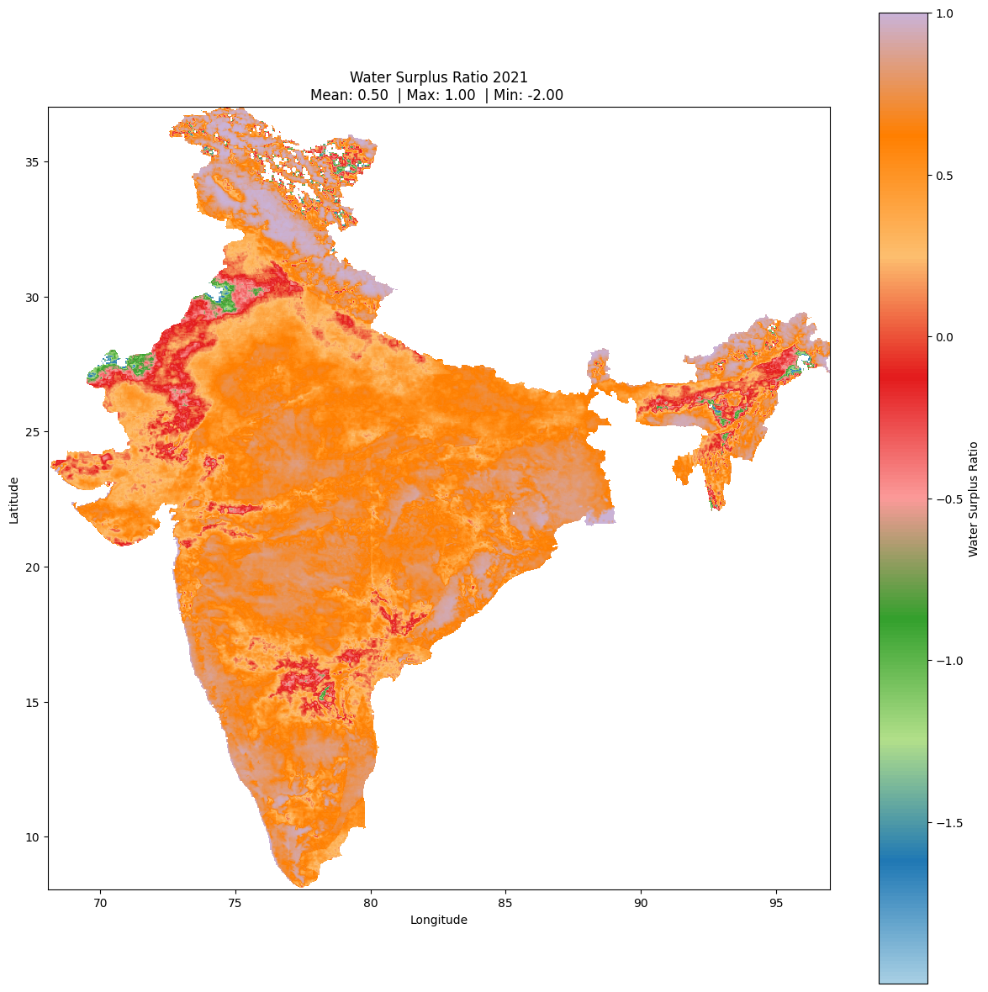
C) Water Surplus Ratio
HEM Precipitation Sum 2021 | AET Sum 2021
Water Surplus Ratio [(HEM Precipitation Sum - AET Sum) / HEM Precipitation Sum]
Fig. Water Surplus Ratio 2021

Slide 20
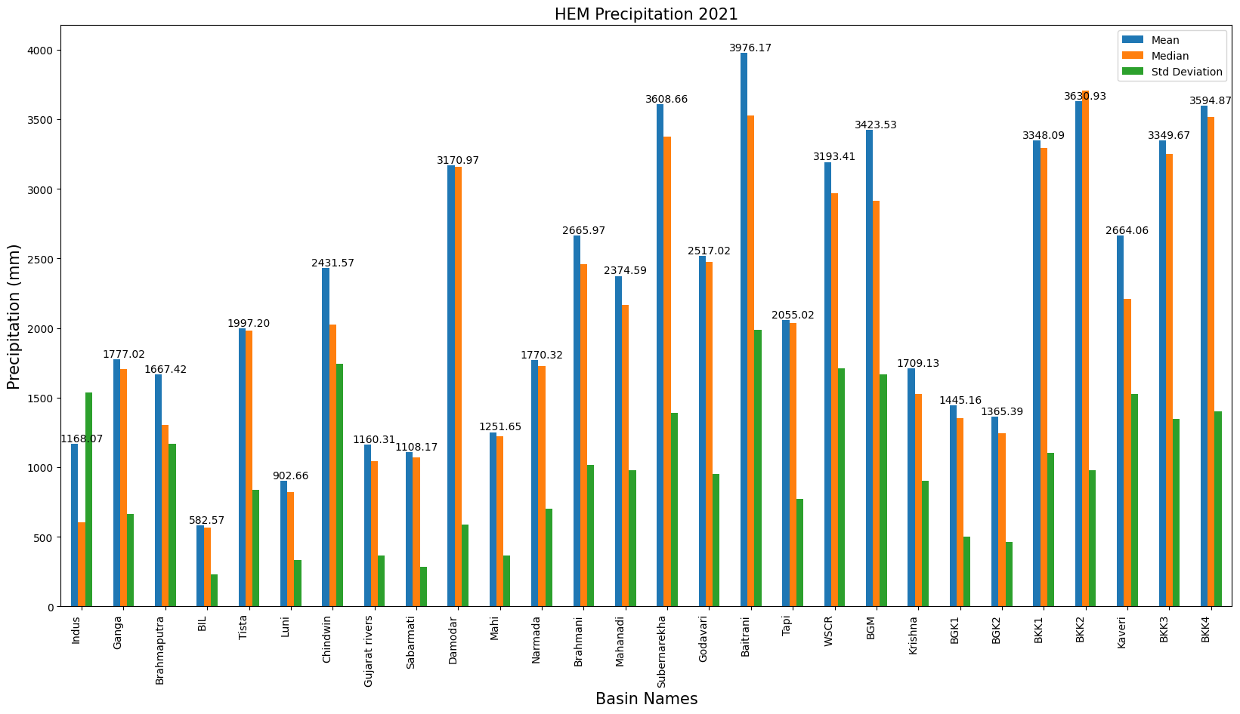
Results and Discussion
A) HEM Precipitation Sum
Fig. HEM precipitation Analysis over different river basins

Slide 21
Fig. Monthly mean precipitation India 2021

Slide 22
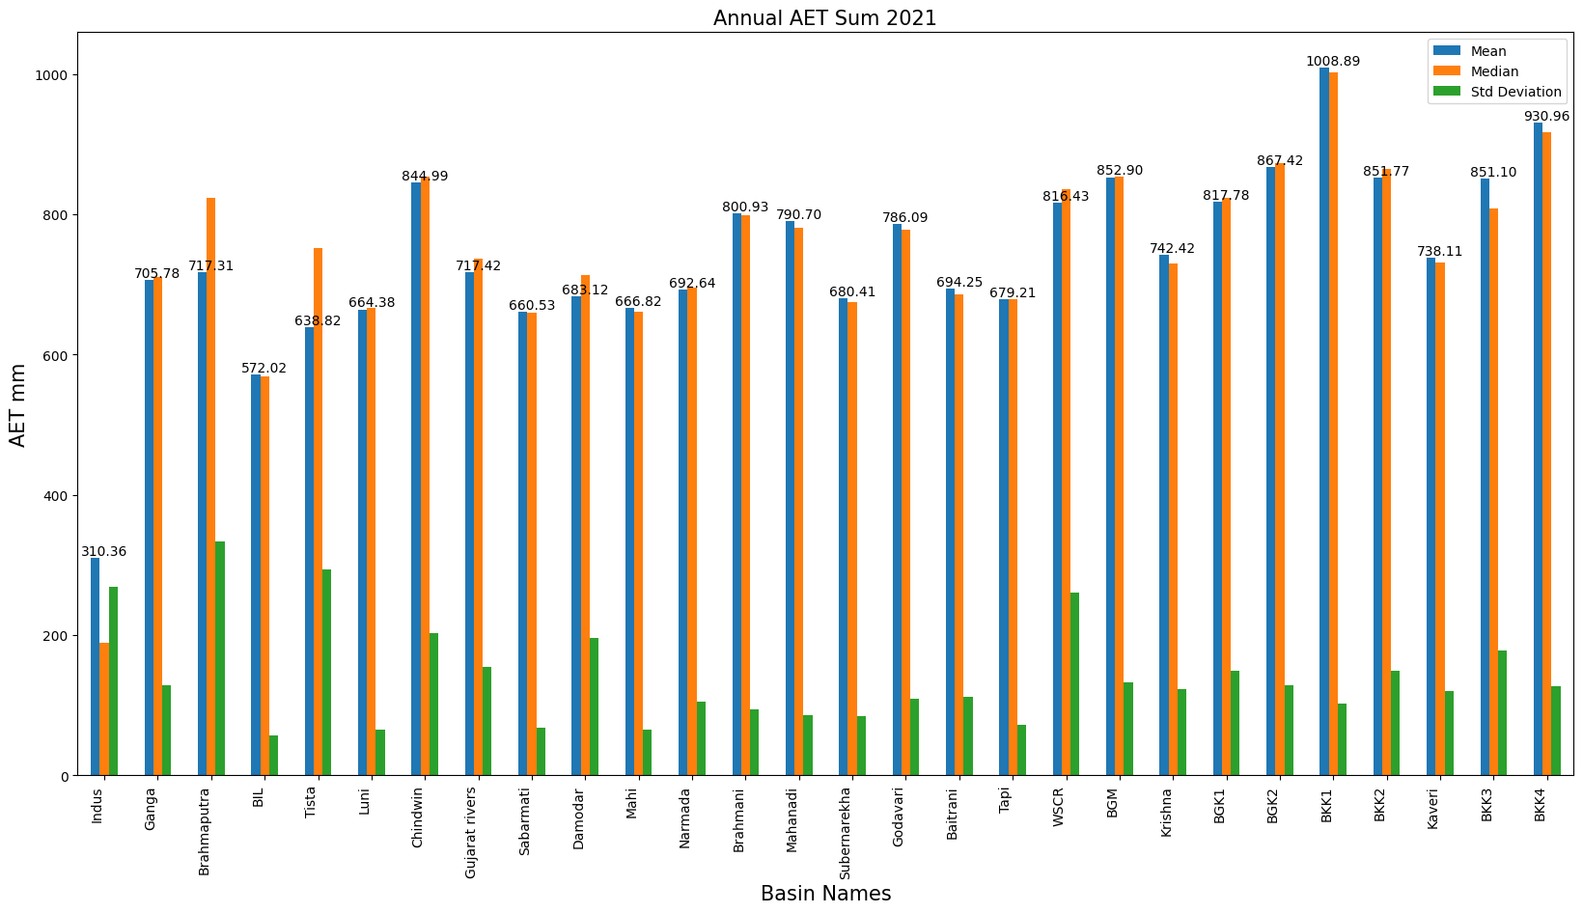
B) Actual Evapotranspiration (AET) Sum
Fig. AET analysis over different river basins 2021

Slide 23
Fig. Monthly Mean AET India

Slide 24
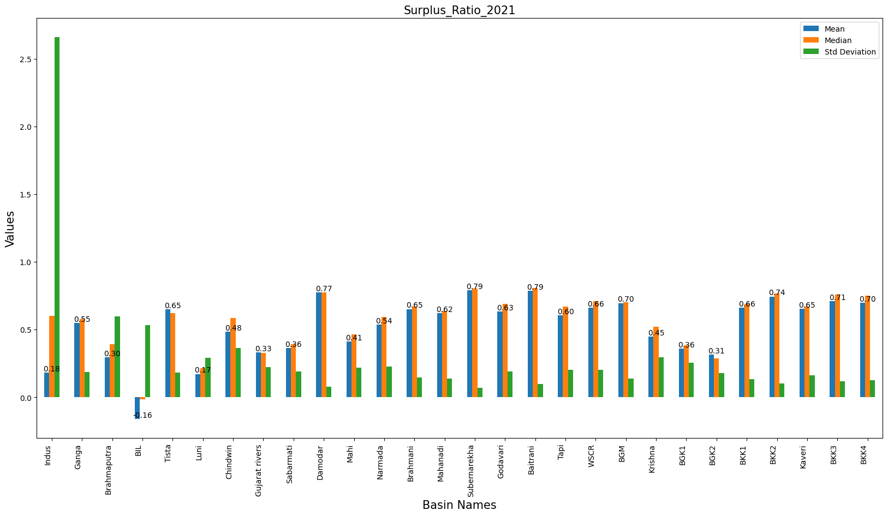
C) Water Surplus Ratio
Fig. Water surplus ratio over different river basins 2021

Slide 25
Outcomes of Max Value Composite Method
The highest mean HEM precipitation is at Baitrani river basin (3976.17mm) and lowest at between Indus and Luni river basin(582.27mm), as well as maximum in the month of July(597.5mm) and minimum in the month of February.
The highest mean AET is at between Krishna and Kaveri 1 river basin (1008.89mm) and lowest at Indus river basin(310.36mm), as well as maximum in the month of October (85.88 mm) and minimum in the month of July(23.39 mm).
The water surplus ratio became positive in all region except BIL (between Indus and Luni) river basin.
In water surplus ratio Indus river basin shows the standard deviation higher than the mean value.

Slide 26
References
Singh, P., Srivastava, P. K., & Mall, R. K. (2021). Estimation of potential evapotranspiration using INSAT-3D satellite data over an agriculture area. Agricultural Water Management (pp. 143-155). Academic Press.
Mitra, A. K., Kaushik, N., Singh, A. K., Parihar, S., & Bhan, S. C. (2018). Evaluation of INSAT-3D satellite derived precipitation estimates for heavy rainfall events and its validation with gridded GPM (IMERG) rainfall dataset over the Indian region. Remote sensing applications: Society and environment, 9, 91-99.
Singh, N., Shukla, B. P., Kaushik, N., Varma, A. K., Mitra, A. K., & Bhan, S. C. (2023). Validation of INSAT-3D/3DR based nowcasting rain occurrences for heavy rainfall using Hydro-Estimator product. Advances in Space Research.
Yucel, I., Kuligowski, R. J., & Gochis, D. J. (2011). Evaluating the hydro-estimator satellite rainfall algorithm over a mountainous region. International journal of remote sensing, 32(22), 7315-7342.
Kumar, P., & Varma, A. K. (2017). Assimilation of INSAT‐3D hydro‐estimator method retrieved rainfall for short‐range weather prediction. Quarterly Journal of the Royal Meteorological Society, 143(702), 384-394.

Slide 27
Thank you

